Slide 1
Unit conversion – support material
Powerpoint by Helen Yip

Slide 2

Unit Conversion
What are GRAPHING UNITS?????
Notes:
Unfortunately, graphing units do not mean anything in the real world!
For example we would not use graphing units when we measure how long a football field is, we would use yards

Slide 3
Unit Conversion
In our coding activities, graphing units are simply placeholders for our actual measurements.
-What BASE UNIT do you think we will use to describe the length of the tank?
Grams
Meters
Liters
Notes:
Base unit. Can increase or decrease by 10s. For example you wouldn’t measure a ladybug with a meter stick, you would probably use a smaller measurement centimeters or millimeters.

Slide 4
Unit Conversion
Since we now know that graphing units are simply placeholders for our actual measurements.
Our job is to convert graphing units to a physical unit that actually exists.
We will do so by calculating how many graphing units are in one meter.
Notes:
So how will we do this?

Slide 5
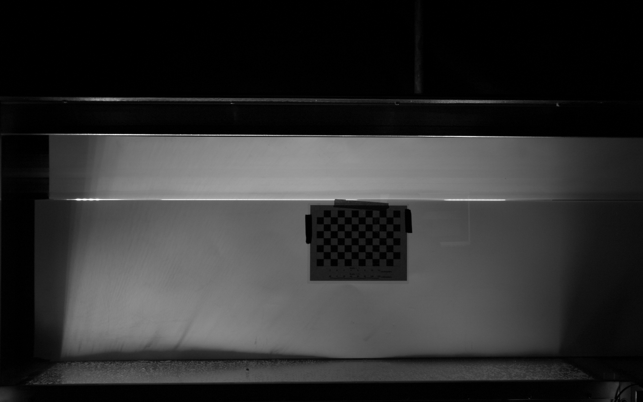
Unit Conversion by using R
Notes:
Our scientist Jessica has provided us this crucial picture in order to convert our graphing units to meters!
She tells us that this picture is 28 cm long.
Our job is to find out how long the paper is in graphing units.

Slide 6
Unit Conversion by using R
Notes:
We will have to find the start and end position of the ruler.
Once we have those coordinates, how do we find out how long the paper is? (Subtract end from start)

Slide 7
Conversion Factors
So now we have how long the paper is in both graphing units AND centimeters. GREAT! Now we can find our conversion factors!
First, let’s find how many graphing units there are per centimeter.
Ex: 4 graphing units (gu)
2 centimeters (cm)
= 2 gu/cm
Notes:
To do this we can simply divide our graphing units by the known centimeters of the paper.

Slide 8
Conversion Factors
Since we found how many graphing units there are per centimeter, let’s find the opposite: How many centimeters there are per graphing unit!
Ex: 2 centimeters (cm)
4 graphing units (gu)
= 0.5 cm/gu
Why is it important to have both conversion factors?
Notes:
To do this we simply flip our numbers, so now its cm over gu.
Does anyone know why it is important to have both conversion factors?
Because if you want to change cm to gu you use the first equation, but gu to cm you use the second equation. So let’s do that!

Slide 9
Perform example with students…

